Slide 1











Multimodal AI System for Early Detection and Interpretable Diagnosis of Skin Lesions
Combining dermatoscopic imagery and patient metadata for enhanced clinical decision support
GROUP 10
Preetham Parmati
Bhumika Chundu
Ushasri Manchala
Venkata Haritha
Machine Learning
Dermatology
Interpretability

Slide 2


















Problem Definition and Clinical Challenges
Critical Need for Early Detection
Limitations of Image-Only Automated Systems
Early detection of malignant skin lesions is crucial for patient survival
Class Imbalance & Rarity
Survival rates drop sharply once melanoma advances beyond the epidermis
Datasets like HAM10000 are dominated by benign nevi, masking subtle features of rare malignant lesions
Dermatoscopic imagery helps clinicians identify suspicious features:
Lack of Multimodal Context
Irregular pigment networks
Automated systems ignore crucial patient metadata that dermatologists routinely use:
Atypical streaks
Abrupt pigment globules
Age and sex
Lesion location
Diagnostic method
Clinical Trust & Interpretability
Without transparent explanations for predictions, clinicians are reluctant to adopt automated tools
Subjective Clinical Interpretation
Interpretation depends heavily on clinician experience and remains vulnerable to:
We need a system that integrates dermatoscopic images and patient metadata, handles class imbalance, and produces interpretable outputs to support both multiclass diagnosis and binary screening.
Subjectivity
Fatigue
Caseload Pressure
2 / 15

Slide 3














Key Technical Challenges
Despite advances in automated skin lesion classification, several technical challenges must be addressed to enable clinical adoption and improved patient outcomes:
Class Imbalance & Rarity
Lack of Multimodal Context
Insufficient Interpretability
HAM10000 dataset dominated by benign nevi (70-80%)
Dermatologists integrate image data with metadata
Clinicians require transparent explanations for predictions
Models biased towards majority class, masking rare malignant lesions
Missing crucial complementary signals:
Without interpretable outputs, tools remain untrusted
Age & sex demographics
Critical malignant classes (melanoma, BCC, AK) underrepresented
Lesion location patterns
Need for both:
Diagnostic method correlations
Multiclass diagnosis explanations
Impact: Poor recall for clinically critical rare classes
Binary screening justifications
Impact: Loss of contextual information that aids diagnosis
Impact: Reduced clinical adoption despite high accuracy
Technical Goal: Develop a system that addresses all three challenges simultaneously, enabling statistically significant improvements over image-only baselines while maintaining transparency and clinical relevance.
3 / 15

Slide 4











Research Hypothesis
Our project posits that an interpretable, multimodal pipeline will significantly improve upon image-only baselines, maintain transparency, and offer actionable fairness diagnostics.
Multimodal Fusion Improves Performance
Balanced Modeling Boosts Screening
Interpretability Maintains Trust
Class-weighted training and optional nevus downsampling will provide statistically significant performance gains
Grad-CAM overlays on images and SHAP analyses on metadata/fusion models will align model explanations with dermatological heuristics
Combining ResNet-based image embeddings with engineered metadata features will yield higher accuracy, macro F1, and ROC-AUC
Early fusion via feature concatenation and late fusion via probability averaging will enhance results
Transparent explanations will foster clinician confidence in the model's predictions
Metadata provides crucial complementary signals that help differentiate visually similar lesions
Particularly important for malignant-vs-benign screening task where recall is paramount
Subgroup metrics (accuracy by sex, age group, localization) will identify fairness gaps for targeted mitigation
Expected to outperform unimodal baselines in McNemar and Friedman significance tests
The integration of multimodal data, balanced modeling techniques, and interpretability tools will create a clinically relevant automated lesion triage system.
4 / 15

Slide 5
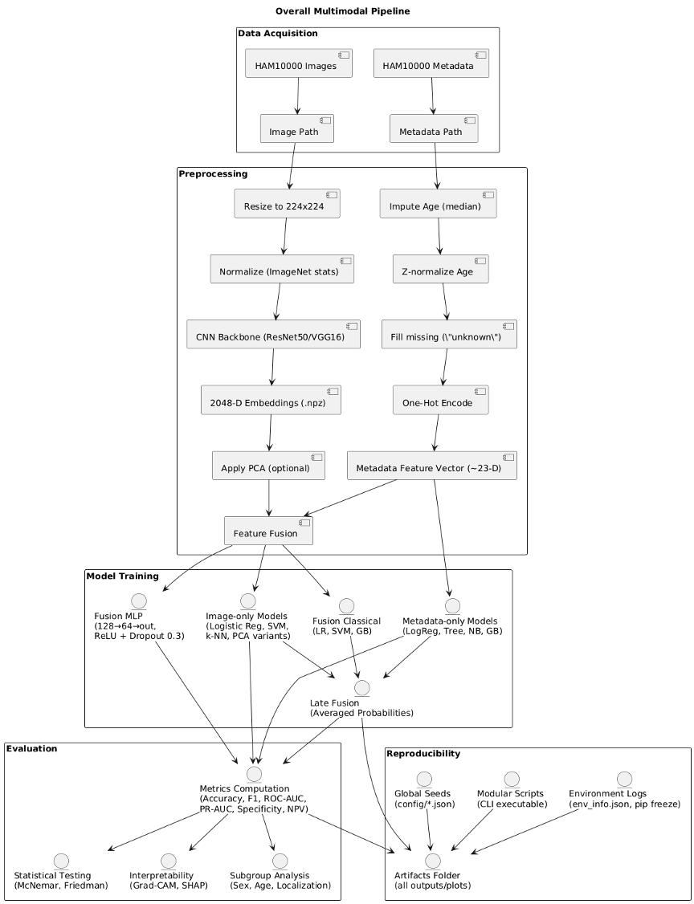











Multimodal System Architecture
Parallel Processing Streams
Image Stream
ResNet50/VGG16 CNN backbone extracts 2048-D embeddings
Optional PCA (>95% variance) reduction
Metadata Stream
scikit-learn ColumnTransformer processes patient data
Handles class imbalance via class weighting
Fusion Strategies
Early Fusion
Late Fusion
Feature concatenation followed by classification
Probability averaging of model predictions
Integrated Modules
Reproducibility
Interpretability
Cached embeddings and scripted transformations
Grad-CAM and SHAP analysis modules
5 / 15

Slide 6



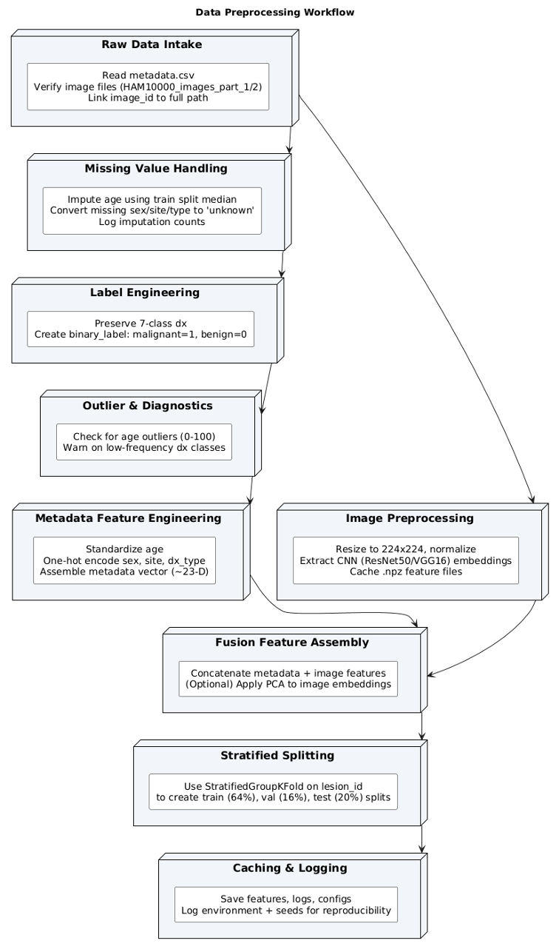















Data Processing Pipeline
Comprehensive Preprocessing Workflow
Preprocessing Workflow Visualization
Our pipeline transforms raw dermatoscopic imagery and patient metadata into structured inputs for model training and evaluation:
Raw Data Intake
Missing Values
Reading metadata CSV, verifying image files, linking IDs to full paths
Imputing age with median from training split; marking missing sex/site/type as 'unknown'
Label Engineering
Stratified Splitting
Maintaining 7-class diagnosis system, creating binary malignancy labels
Enforcing stratified, lesion-aware splits via StratifiedGroupKFold
Image Preprocessing
Metadata Feature Engineering
Resizing to 224×224 pixels, normalizing
Standardizing age, one-hot encoding categoricals, assembling 23D vector
Key Benefits of Our Approach
All transformations are scripted to ensure exact consistency during evaluation/inference, enabling reliable model comparison and deployment.
Handles class imbalance
Preserves data integrity
Enables reproducible results
Supports both image and metadata streams
6 / 15

Slide 7



























Image and Metadata Stream Processing
Image Stream
Metadata Stream
ResNet50 extracts 2048-D embeddings
ColumnTransformer processes features
Parallel Processing
Standardizes age, encodes categories
Uses torch.no_grad() mode
Caches embeddings (.npz)
Handles class imbalance:
Optional PCA (>=95% variance)
class_weight='balanced'
Optional nevus downsampling
Feature Caching
Supported Models
Caches plus metadata preprocessors are stored for reproducible evaluation:
Image-only
Metadata-only
Logistic regression, SVM, k-NN
LR, Decision tree, Gaussian NB, GB
Feature reproducibility
Avoid recomputation
Reloadable preprocessors
PCA variants
Fusion models
Dimensionality reduction
Early and late fusion strategies
7 / 15

Slide 8



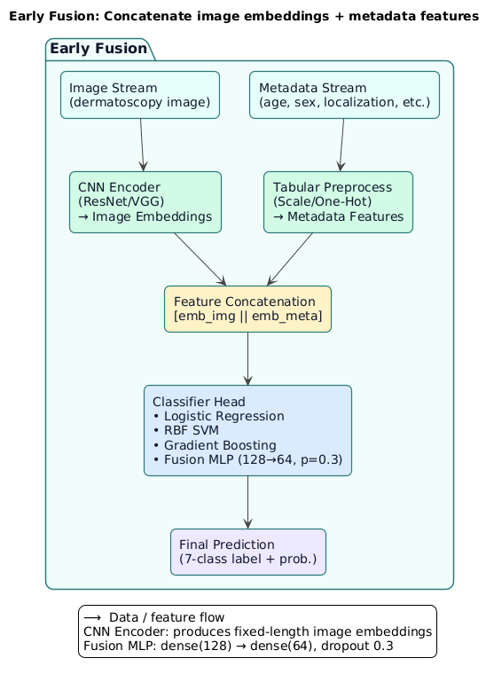
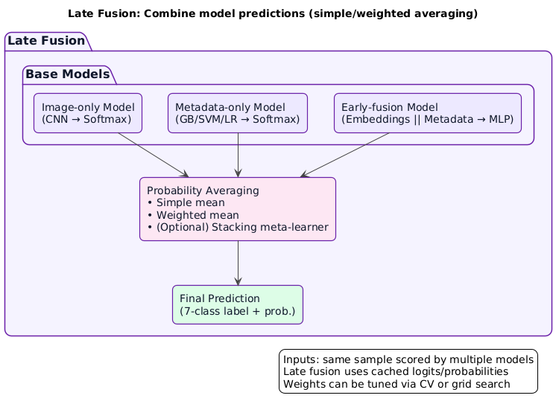
Fusion Strategies and Model Integration
Early Fusion
Late Fusion
Feature concatenation of image embeddings and metadata features
Probability averaging combines predictions from multiple models
Input: [image embeddings || metadata features]
Combines image-only and metadata-only predictions
Models: Logistic regression, RBF SVM, gradient boosting, Fusion MLP
Simple averaging and weighted late fusion options
Fusion MLP: 128→64 hidden layers with dropout 0.3
Uses cached features to avoid recomputation
Fusion strategies enhance performance by combining complementary signals from images and metadata
8 / 15

Slide 9



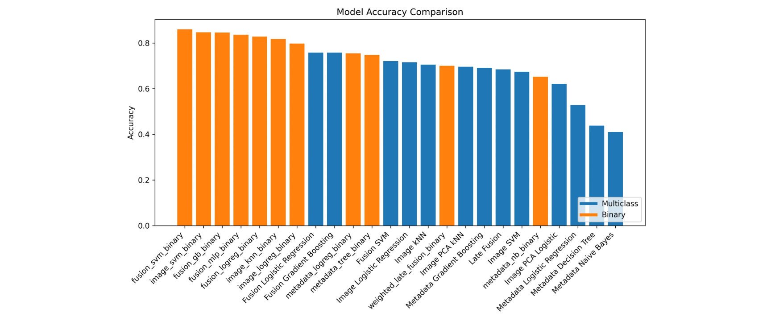








Multiclass Classification Results
Fusion Gradient Boosting Performance
Model Accuracy Comparison
75.8%
0.559
Accuracy
Macro-F1
Best performance among all models evaluated
Statistically significant improvement over image-only baseline
Model Comparison
Model
Accuracy
Macro-F1
Fusion Gradient Boosting
0.758
0.559
Fusion Logistic Regression
Key Insights
0.750
0.550
Image-only Logistic Regression
Why Fusion Outperforms
0.715
0.483
Combines visual patterns with contextual metadata
Metadata-only Logistic Regression
0.410
0.310
Balances class representation
Provides complementary signals for decision making
Limitations
Metadata-only models show poor performance (0.41 accuracy), confirming dermatologists rely on more than just patient data.
9 / 15

Slide 10




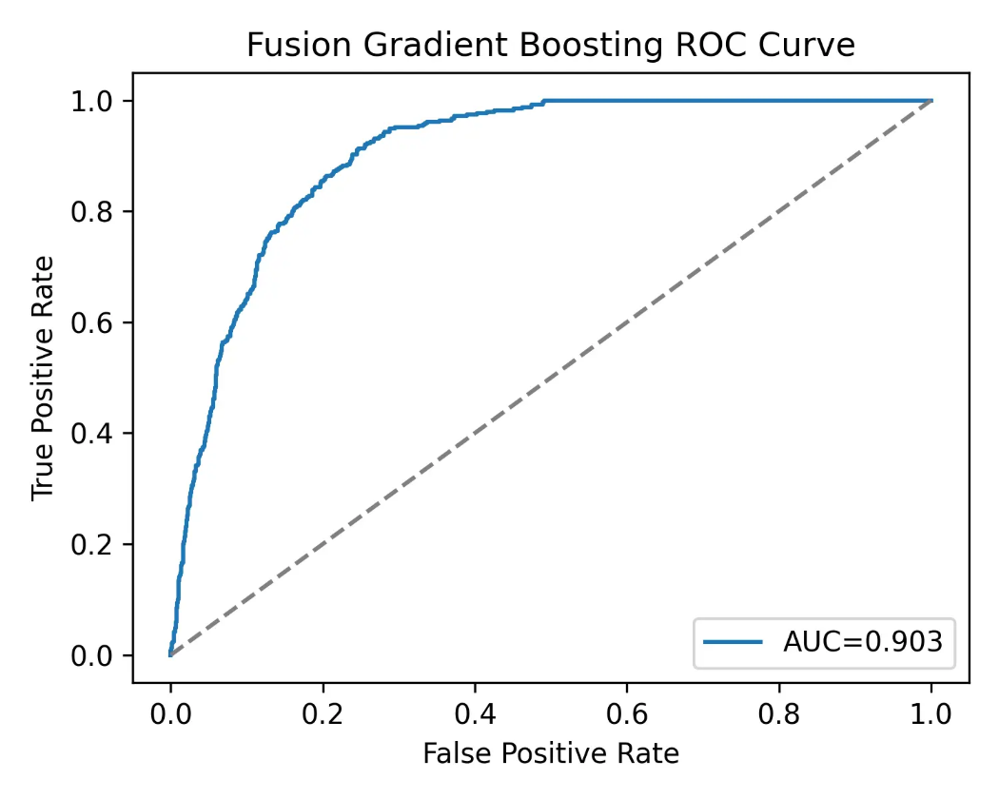





Binary Screening Performance
Malignant vs. Benign Classification
ROC Curve Analysis
Fusion models demonstrate strong performance for the critical binary task of distinguishing malignant from benign lesions:
Fusion models achieve ROC-AUC ≈ 0.90
This represents significant improvement over image-only and metadata-only baselines, particularly for the malignant recall task where recall is critical.
Key Findings
Fusion Gradient Boosting ROC Curve (AUC = 0.903)
Top performers: Fusion Logistic Regression and Fusion Gradient Boosting deliver best results
Late fusion: Probability averaging between image and metadata models adds robustness
Performance Comparison
Fusion Models
Image-only
Metadata-only
Precision-recall: Improved metrics over image-only and metadata-only baselines
0.90
0.75
0.70
ROC-AUC
ROC-AUC
ROC-AUC
10 / 15

Slide 11














Statistical Significance Testing
Statistical significance tests confirm that fusion models outperform unimodal baselines with high confidence.
McNemar's Test
Friedman Test
Comparison: Fusion vs. Image-only Logistic Regression
Models ranked: Image LogReg, Image SVM, Metadata LogReg, Fusion LogReg
Task: Binary screening performance
Task: Accuracy/error counts across datasets
Statistic: 19.38
p-value: ≈ 1.1 × 10⁻⁵ < 0.5
Statistic: 110.28
p-value: ≈ 9.5 × 10⁻²⁴ < 0.5
Interpretation: Fusion logistic regression produces significantly fewer classification discrepancies.
Interpretation: Fusion models consistently rank higher than image-only baselines.
These statistical tests provide strong evidence that multimodal fusion approaches are superior to unimodal methods.
11 / 15

Slide 12





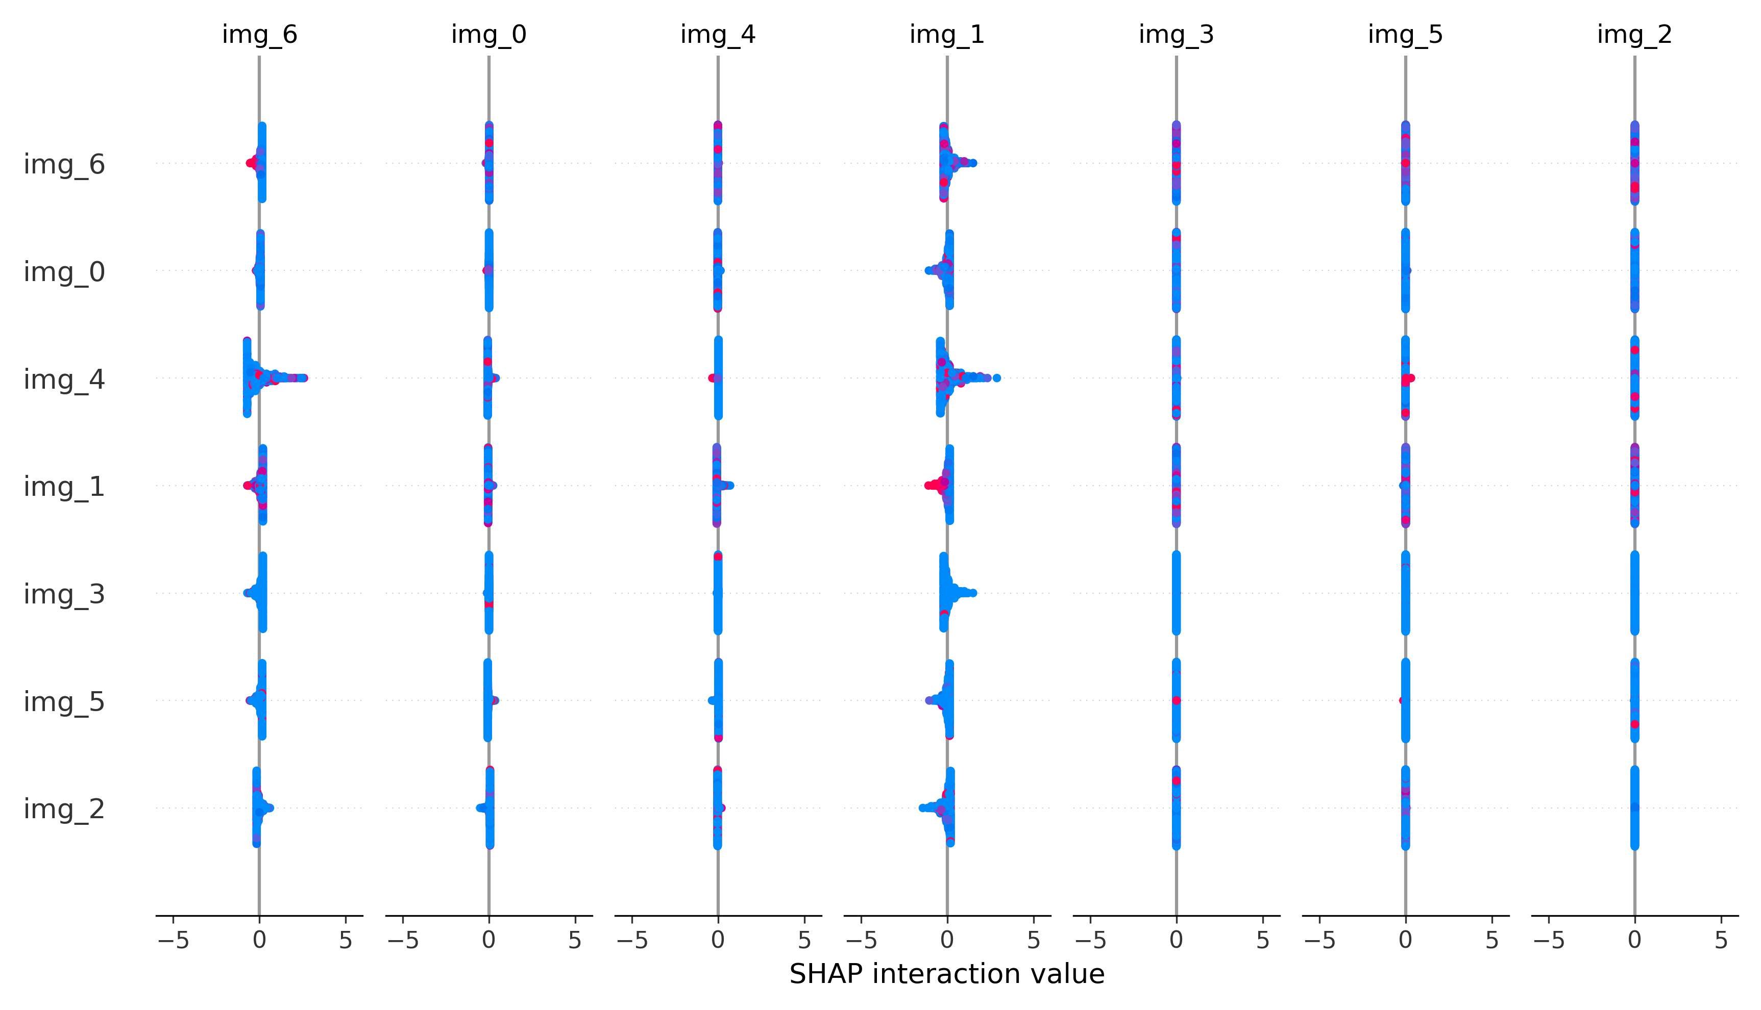
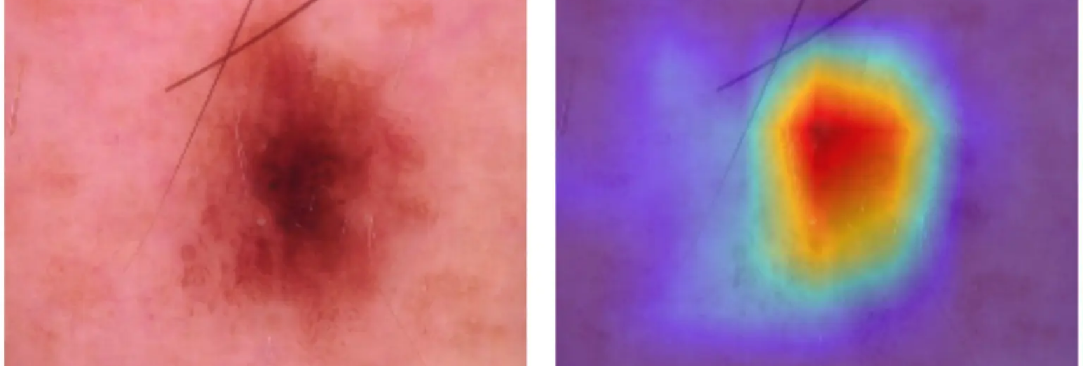
















Interpretability and Clinical Trust
Grad-CAM Overlays
SHAP Analysis
Gradient-weighted Class Activation Mapping highlights regions of dermatoscopic images that influence model predictions.
SHapley Additive exPlanations provides transparent insights into metadata and fusion model decisions.
Highlights suspicious pigment networks and patterns
Identifies age and localization as key drivers
Reveals which skin features the model considers most relevant
Quantifies feature contributions to predictions
Clinical Impact
Building Trust Through Transparency
Grad-CAM heatmaps align model explanations with dermatological heuristics:
Clinical Reasoning
False Positive Analysis
Aligns model decisions with dermatological expertise
Explains why benign cases are classified as such
Focus on irregular patterns
Attention to lesion borders
Detection of pigment variations
Fairness Assessment
Continuous Improvement
Identifies potential demographic disparities
Feedback loop for model refinement
12 / 15

Slide 13




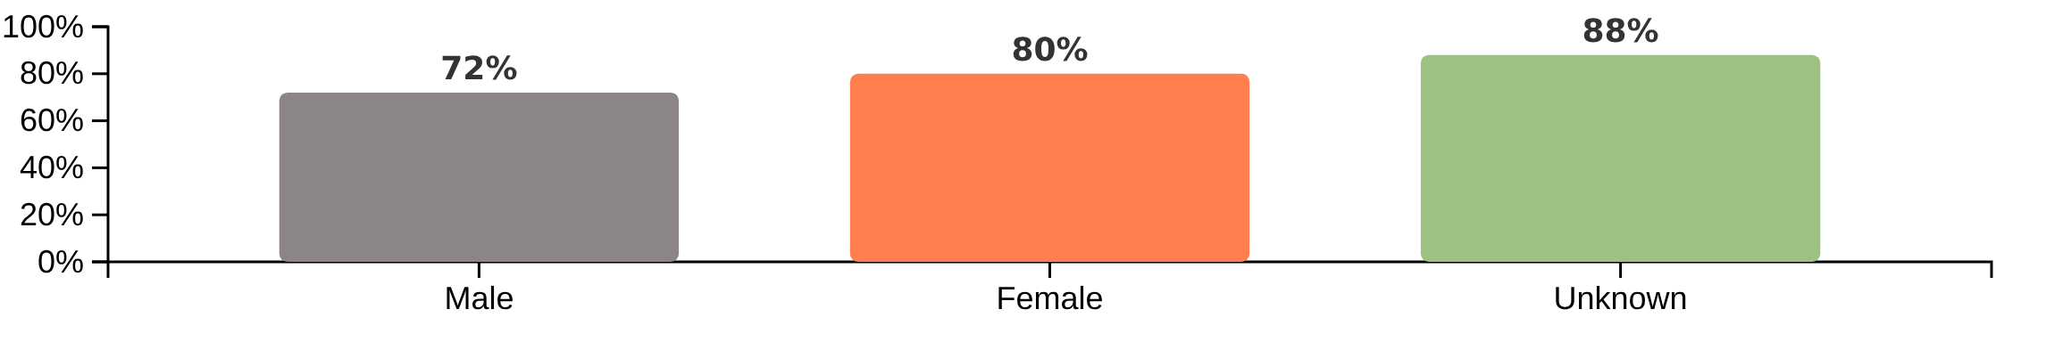
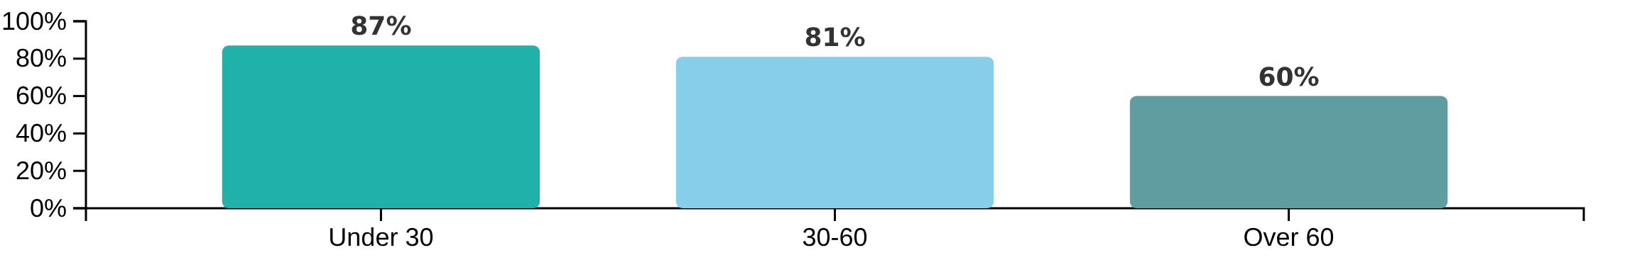



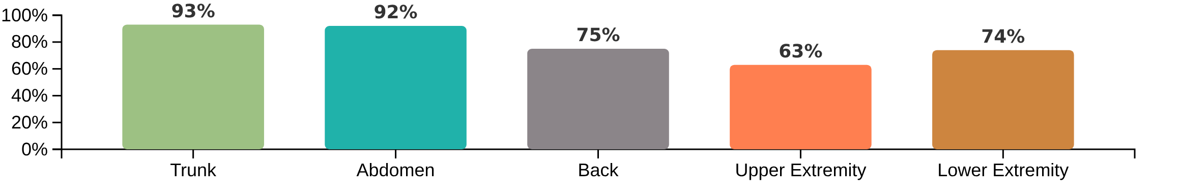
Fairness and Subgroup Analysis
Why Subgroup Analysis Matters
Accuracy by Sex
Evaluating model performance across demographic groups is essential for:
Identifying potential bias in automated systems
Ensuring equitable healthcare outcomes
Guiding targeted data augmentation efforts
Accuracy by Age Group
Key Insights & Next Steps
Performance gaps highlight areas for targeted data augmentation
Age group over 60 shows lowest accuracy (60%)
Accuracy by Localization
Lower extremity localization (63%) has the lowest accuracy among body sites
13 / 15

Slide 14















Key Lessons and Clinical Impact
Our investigation revealed three critical insights with significant clinical implications:
Metadata Provides Diagnostic Value
Classical Models Remain Competitive
Interpretability Builds Trust
SHAP analysis identifies age, localization, and biopsy referral as top contributors
Class-weighted logistic regression and gradient boosting prove strong benchmarks
Grad-CAM overlays highlight model "attention" areas
SHAP waterfalls show feature contributions for individual predictions
Fusion models show higher recall for malignant classes
PCA reduction helps maintain performance while improving interpretability
Aligns model reasoning with dermatological heuristics
Metadata drives better decisions on similar dermatoscopically
Easier to explain and calibrate than deeper neural networks
Clinical Impact
Enhanced Decision Support
Actionable Insights
Clinical Workflow Integration
Builds confidence in automated tools
Identifies areas for targeted data augmentation
Designs for real-world deployment
14 / 15

Slide 15









Future Directions and Applications
Expanding Metadata & Temporal Context
Advanced Fusion Architectures
Clinical Implementation & Monitoring
Incorporate longitudinal patient history and lesion evolution data
Investigate attention-based fusion mechanisms
Develop pipeline for real-time inference in clinical settings
Expand clinical notes integration for richer context
Replace simple concatenation with dynamic weighting of metadata vs. image features
Add model monitoring dashboards for performance tracking
Automated fairness checks already identify demographic gaps
Log SHAP/Grad-CAM outputs for every decision to maintain interpretability
Explore vision transformers for more sophisticated integration
Next steps: targeted data augmentation or resampling to address disparities
Integrate user feedback loops for continuous improvement
Radar charts show fusion already leads; more sophisticated integration could push this further
By highlighting these future directions, our multimodal AI system will become an increasingly valuable tool for dermatologists, combining clinical interpretability with continuous learning from real-world deployment.
15 / 15

